Slide 1

THE WHEEL DEAL
Cristina Bindschatel, Jennifer Brown, Luke Jeries, Nicholas Sammut,
Taylor Shephard, Will Rieske, and Dan Wiseman
Cristina

Slide 2
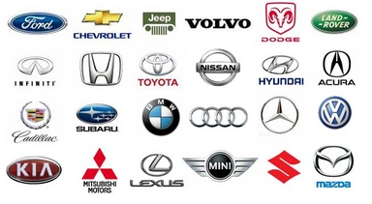
Scope
The App Does
Identifies the car's make and model
Provides GPS location of where the picture was taken.
Uploads the pictures to a personal gallery.
Has a system of points, weekly challenges and trophies.
The App Does Not
Detect the year of the car, or who the driver is.
Tell you what the license plate number is.
Allow you to manually input the car's information.
Taylor

Slide 3
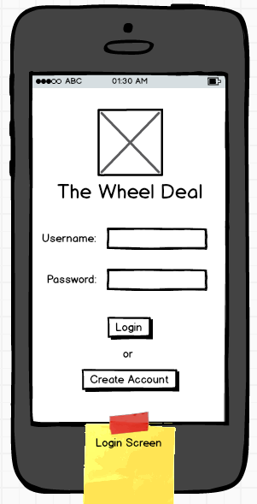
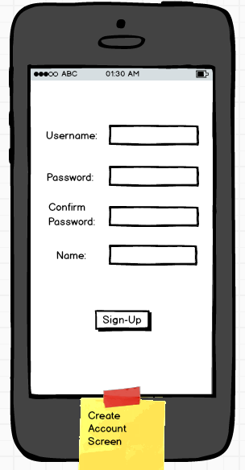
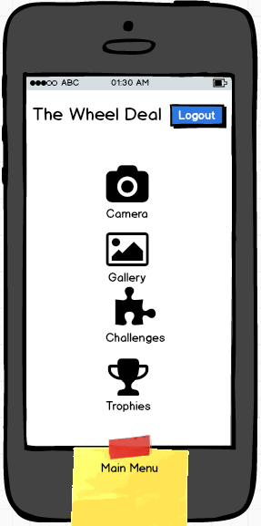
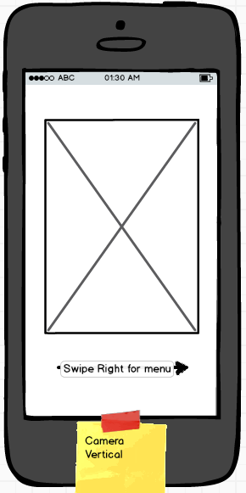
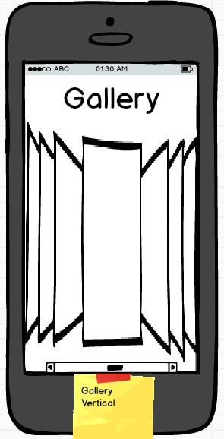
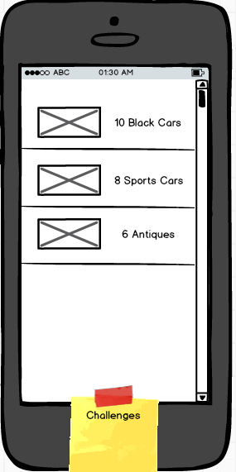
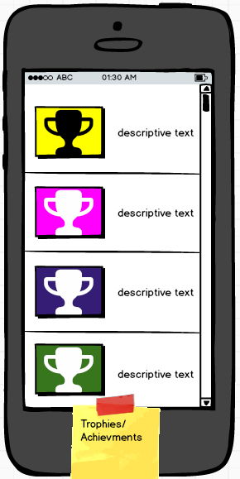
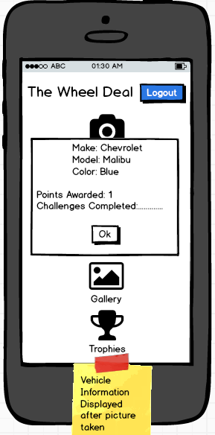
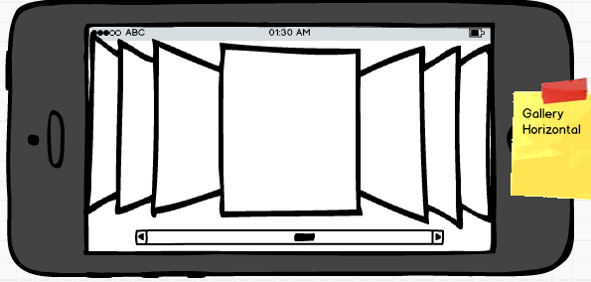
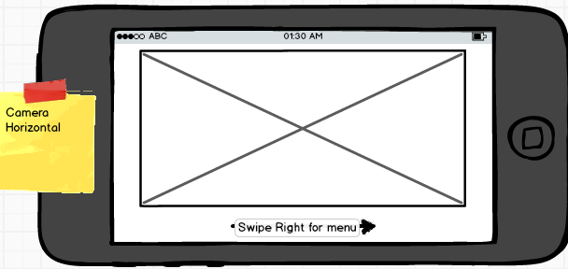
Storyboard
Balsamiq
Taylor

Slide 4

Personas
Name | Description
Sarah Clark | Loves Cars Likes searching games Very Competitive College Student Is on her phone most of the day
Bill Billerson | Vintage car enthusiast Loves identifying cars and testing his knowledge Works on cars in his spare time Just got a smartphone and wants something easy-to-use
Catherine Aberjeen | 18 year old Tomboy No personal interest in cars Friends are all car enthusiasts Likes playing games with friends
Neil Edwards | 21 year old Exotic car enthusiast Wants a place to store pictures of cars (rather than his smartphone) Works in a car shop Likes multiplayer videogames
Bill Jackson | 48 years old Medically separated from Military Vehicle Mechanic Collects vintage car models Avid Car Show attendee
Will

Slide 5
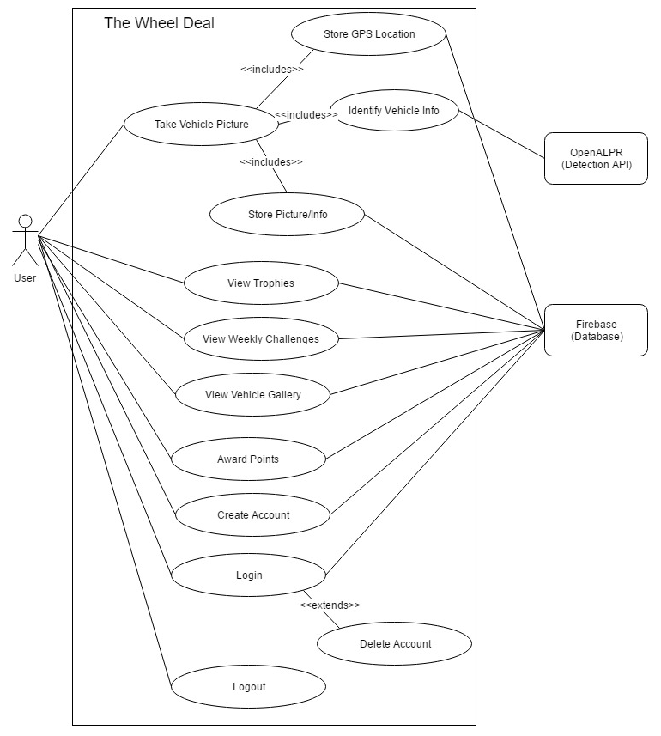
Use Case Diagram
Cristina

Slide 6
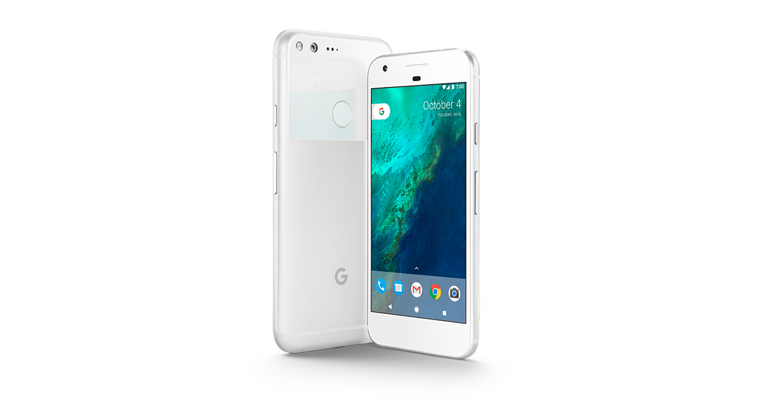
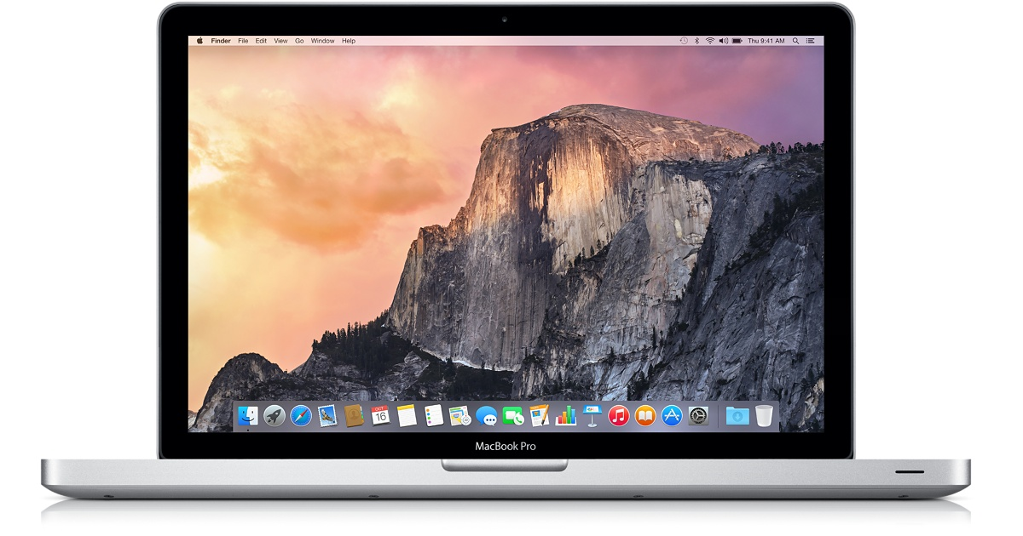


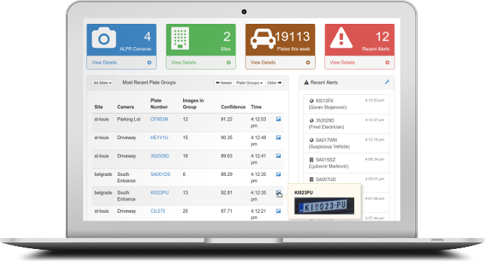




Technologies Used
Hardware
Android Phone
Computer
Software
OpenALPR
(Car Recognition API)
Android Studio
Firebase
Github
Slack
Dan

Slide 7
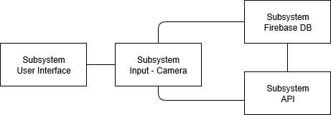
Architecture Diagram
Jenna

Slide 8
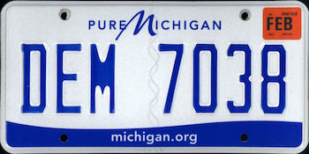
Challenges and Future Improvements
Getting Firebase to work was challenging
License plate must be readable for the API to work (Search for one that doesn’t require this)
We wanted to explore the option of using Google Play Store so that a user can use their ID to sign into the app
Create leaderboards
Add more features to the challenges and trophies
Jenna

Slide 9

Android Classes Used
Picture Data Packet
Container class for picture information
Saves location and processed Vehicle details
Vehicle
Custom class used for OpenALPR API
Saves make, model, color
Luke

Slide 10

The Demo
Backup: https://drive.google.com/file/d/0B6eobBTqbUC6ck1VZTJMN2xBMTQ/view?usp=sharing
Firebase:
https://console.firebase.google.com/project/thewheeldeal-40e3e/overview
Nick

Slide 11
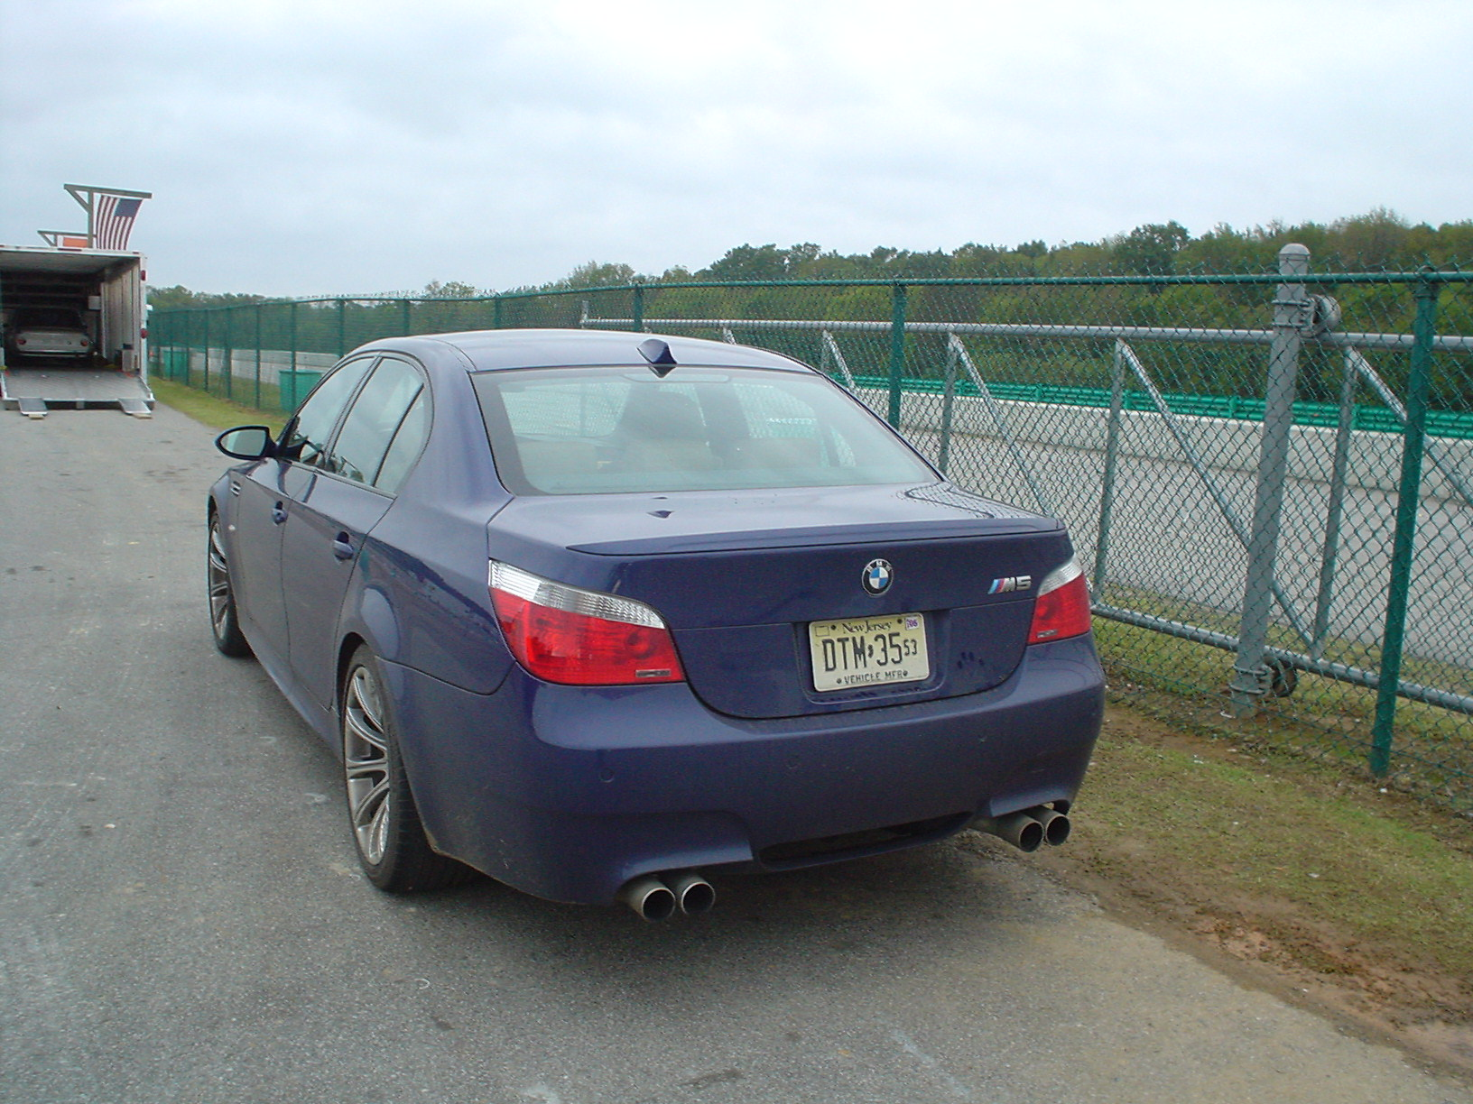
The Demo
Nick

Slide 12
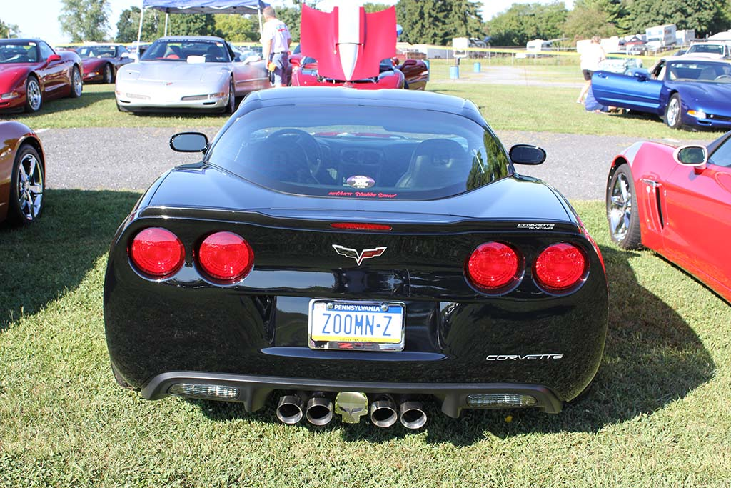
The Demo
Nick

Slide 13
Questions?
Nick

Slide 14
https://github.com/NSammut/TheWheelDeal

